Slide 1
CS602 Project Shopping cart application
Xiaobing Hou

Slide 2
Project introduction
Language: Node.js
Database: MongoDB
Used Modules: express, handlebars, mongoose, body-parser, request
Run Project:
Initialize the database
Command: node initDB.js
Start Program
Command: node server.js
Project functions: The project’s functions are completed according to the requirements of the project guideline file

Slide 3
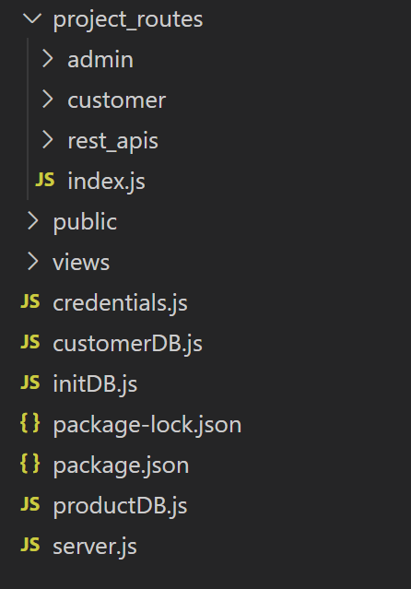
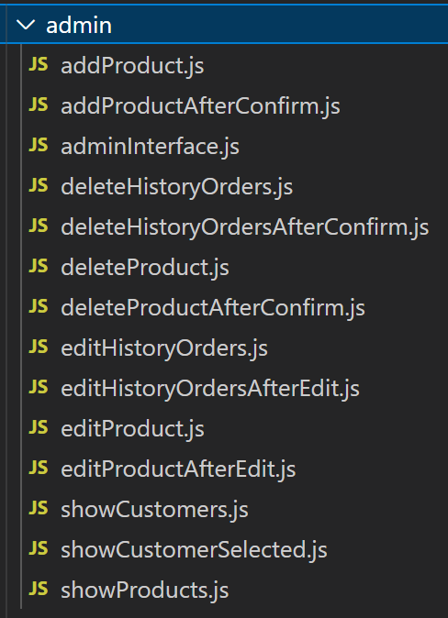
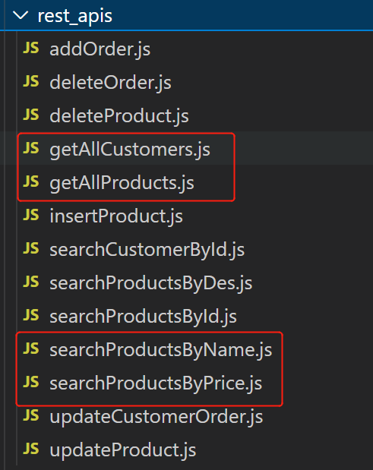
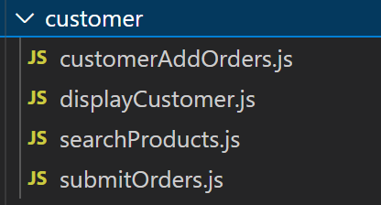
Project File Structure

Slide 4
REST APIs created in the program
Name: get all products.
Purpose: To get all the products data.
Name: search products by name.
Purpose: To get all the products data which have a special name.
Name: search products by description.
Description: To get all the products data which have a special description.
Name: search products by id.
Description: To get certain product data via product id.
Name: insert product.
Description: To insert a product data into database.
Name: delete product.
Purpose: To delete one product data from database
Name: update product
Purpose: To update certain product’s information

Slide 5
REST APIs created in the program
Name: add order
Description: To insert an order data into certain customer’s orders
Name: delete order.
Purpose: To delete one order from certain customer
Name: update customer order
Description: To update certain order of certain customer
Name: get all customers
Description: To get all customers data from database
Name: search customer by id
Description: To get certain customer data via customer id from database

Slide 6
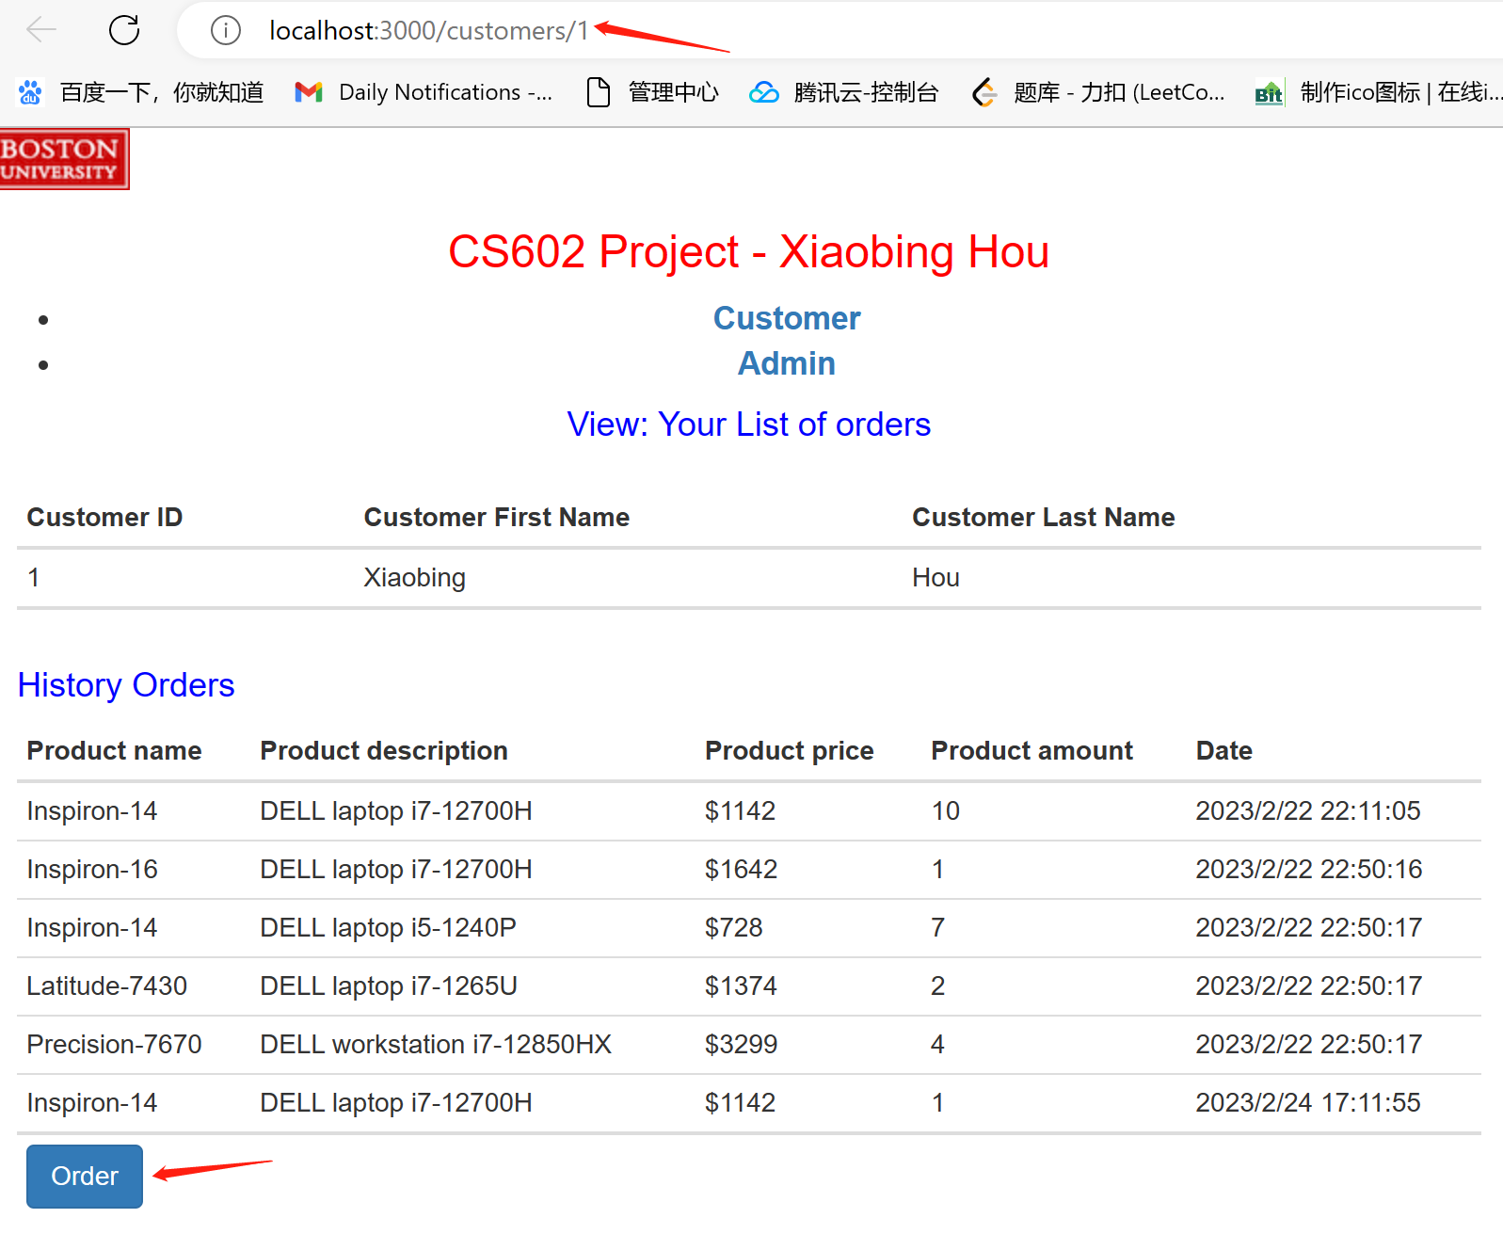
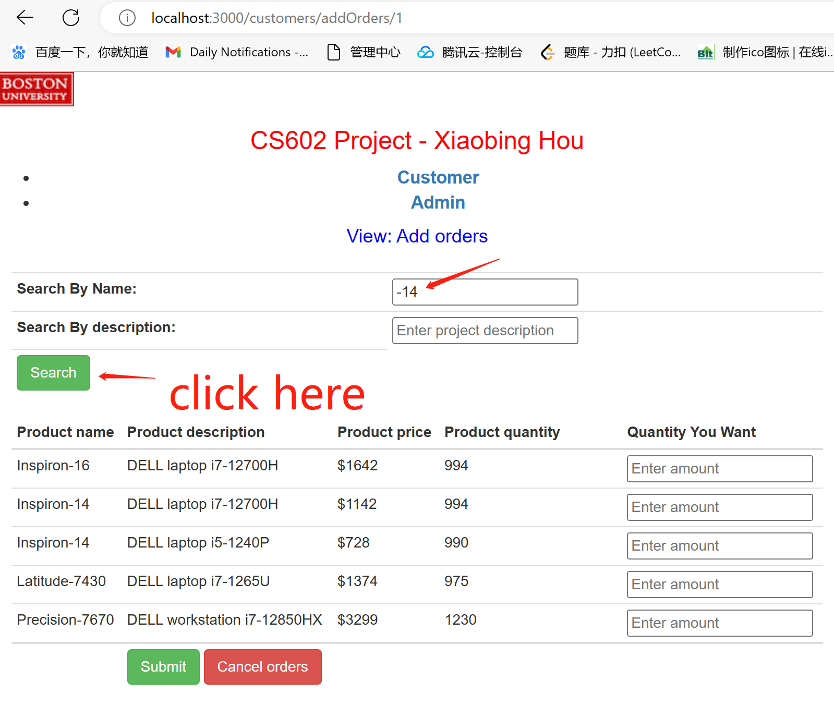
Demo presentation-Customer

Slide 7
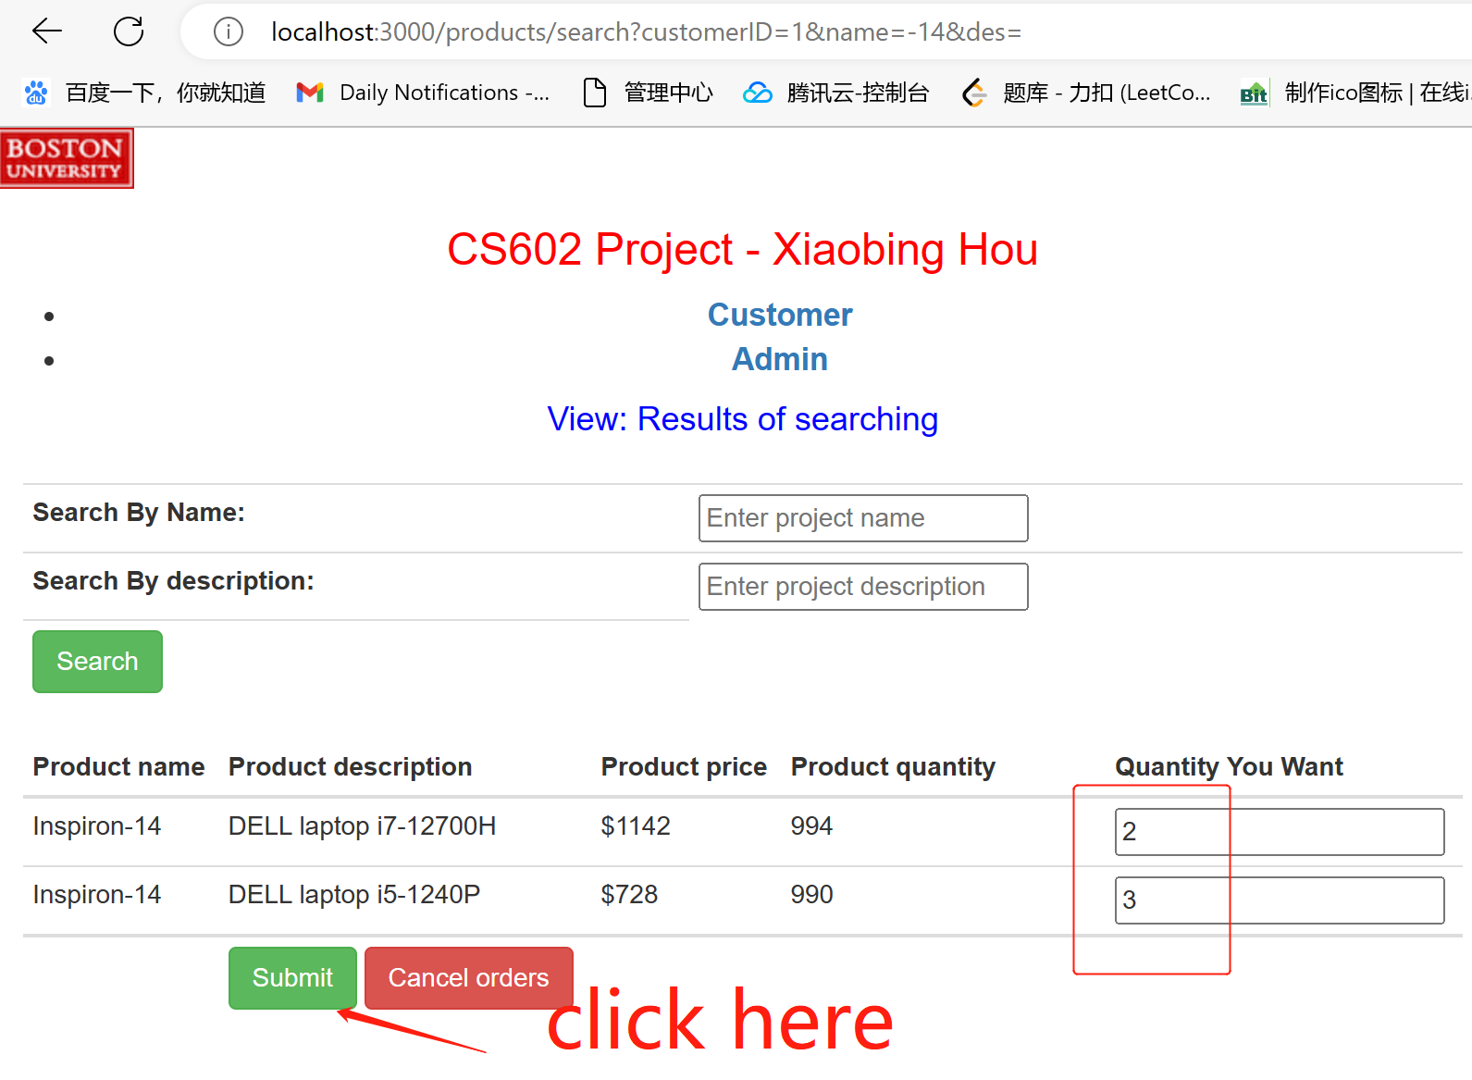
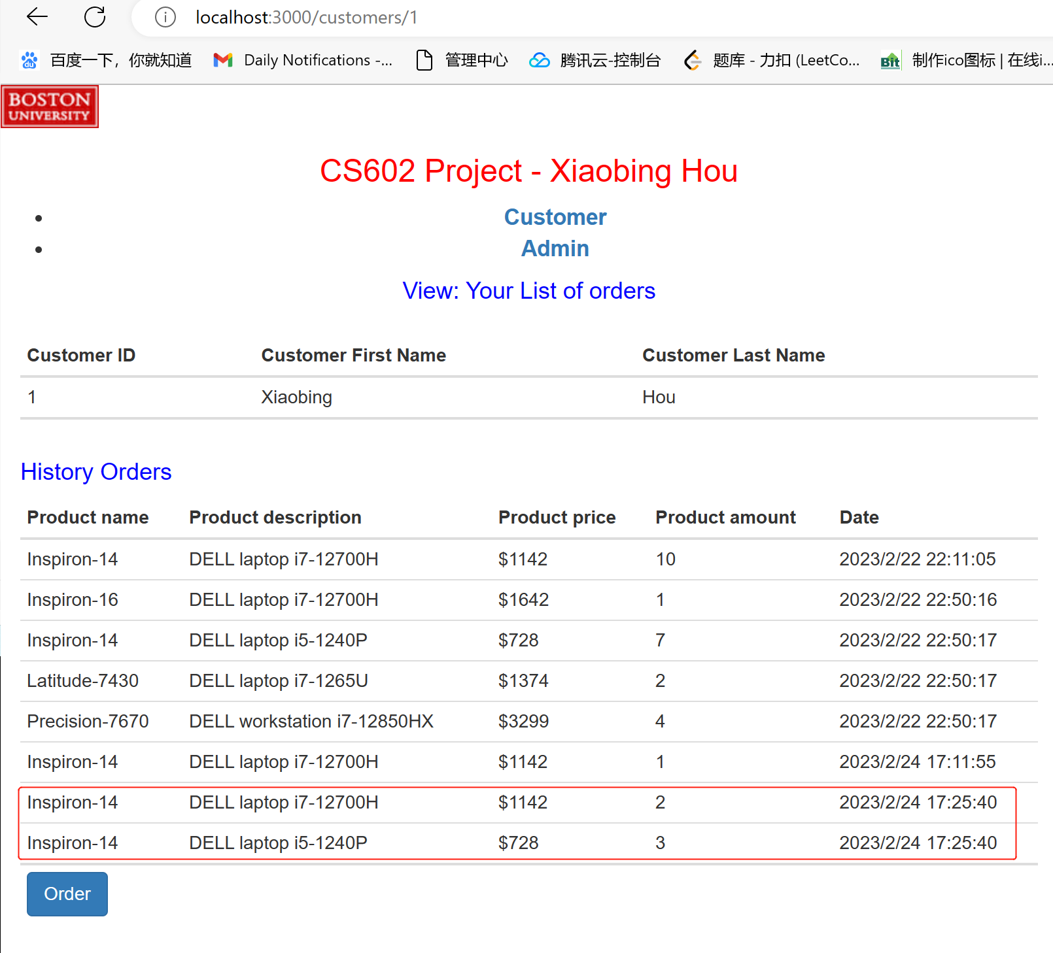
Demo presentation-Customer

Slide 8
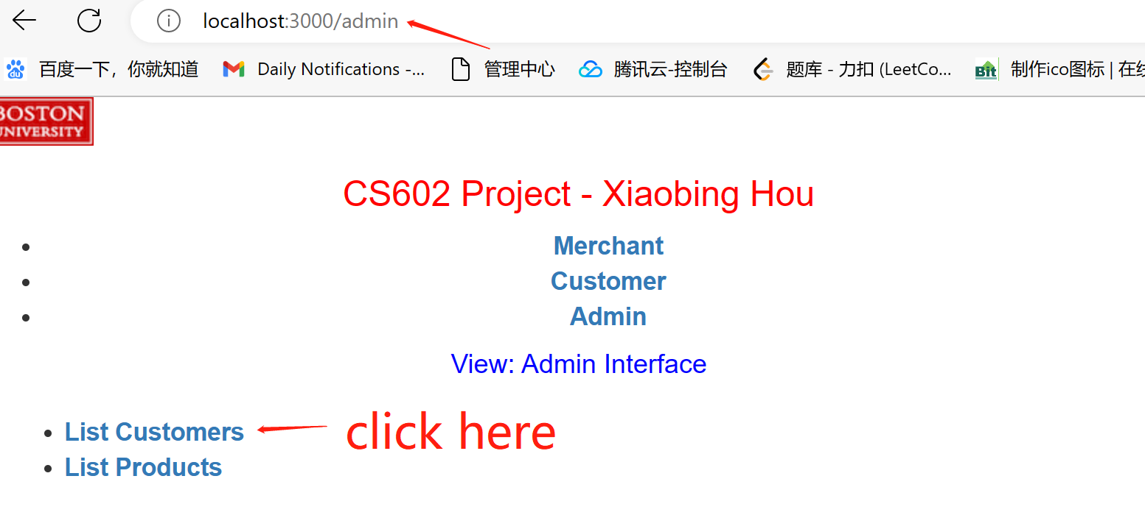
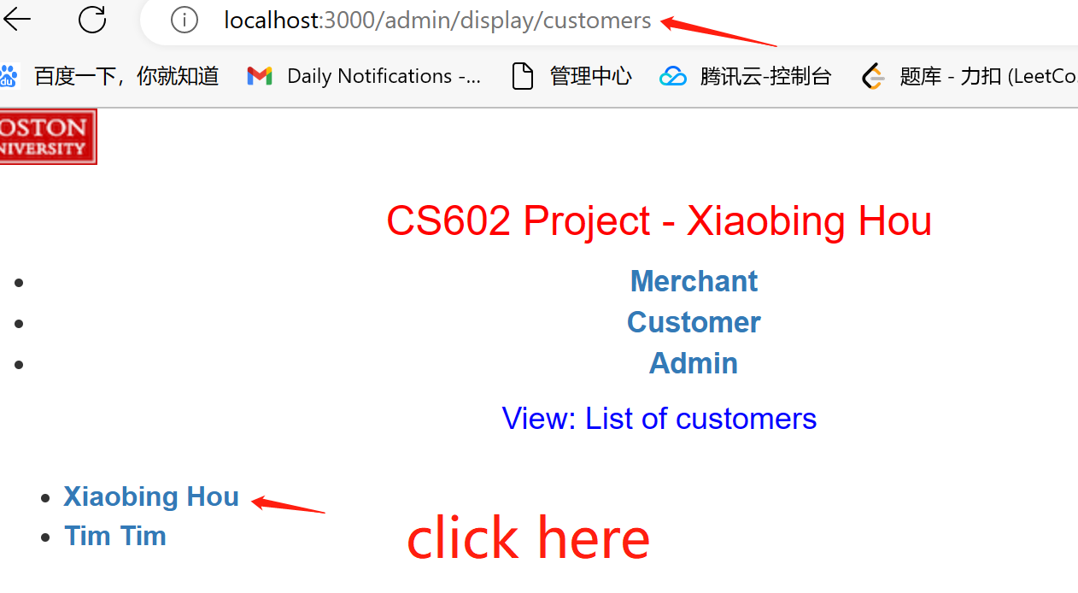
Demo presentation-Admin

Slide 9
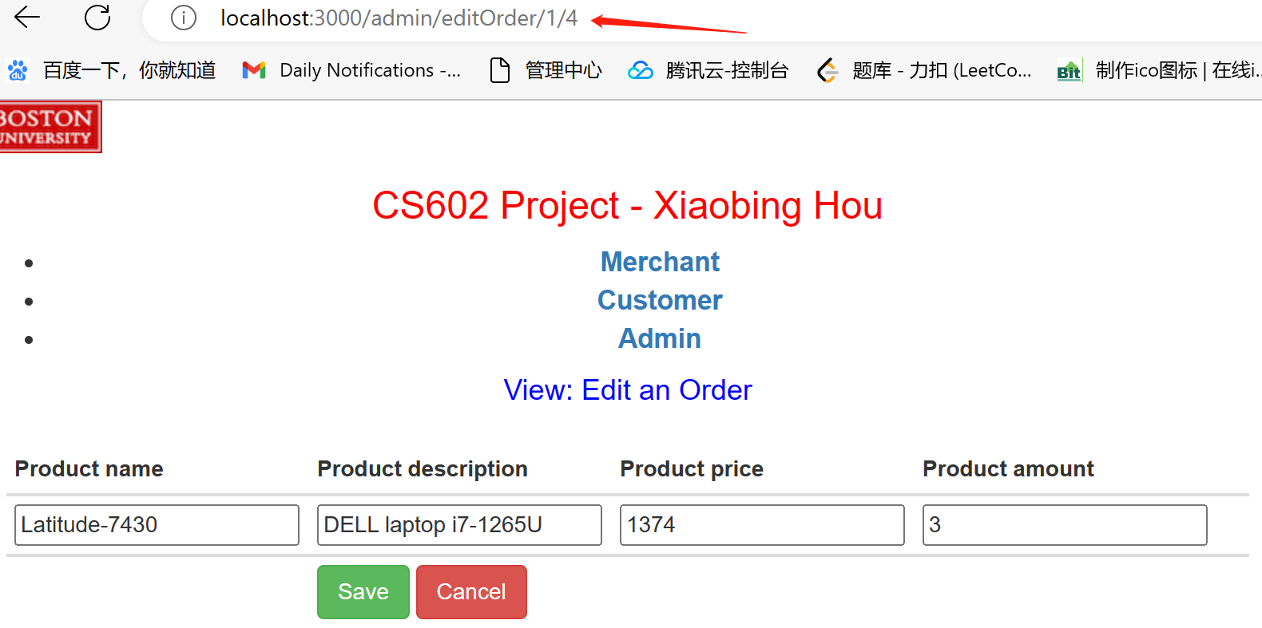
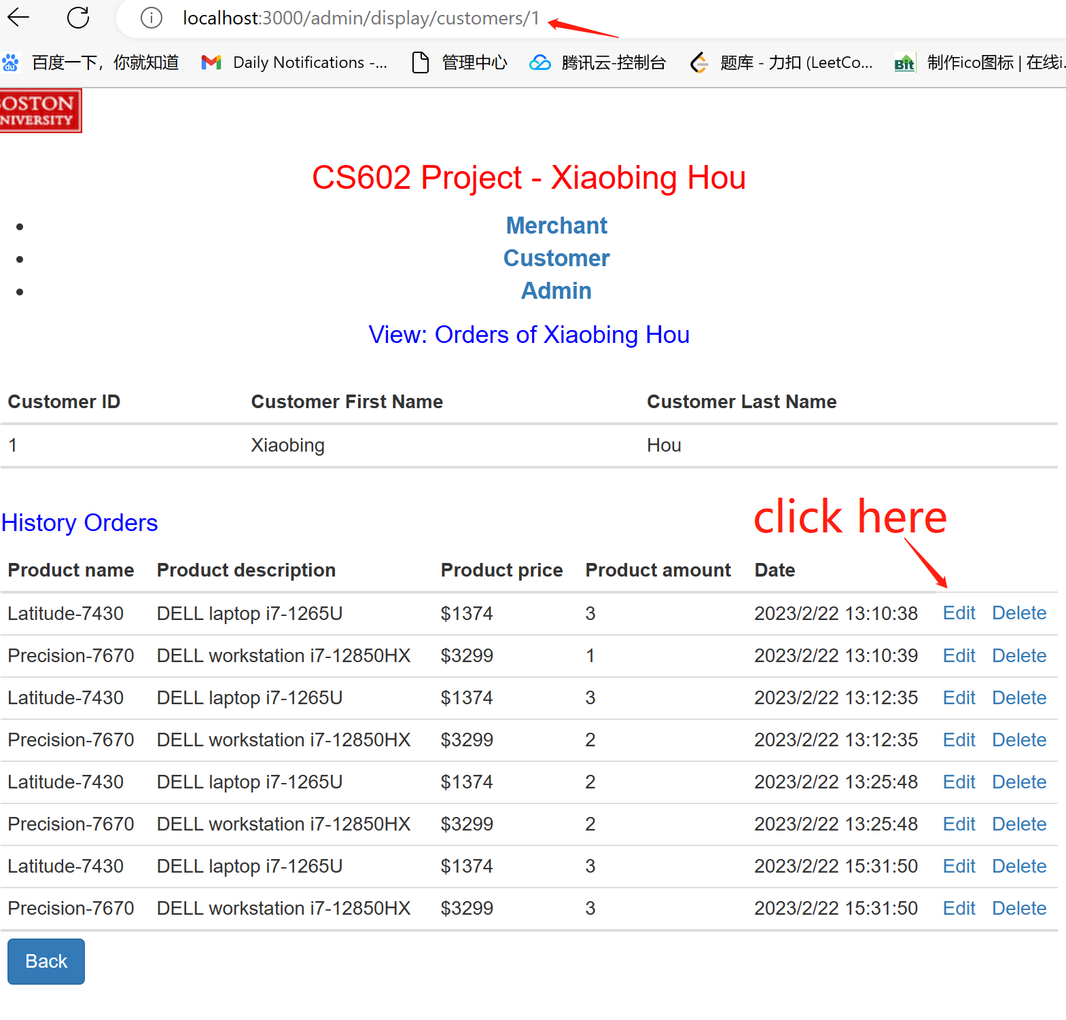
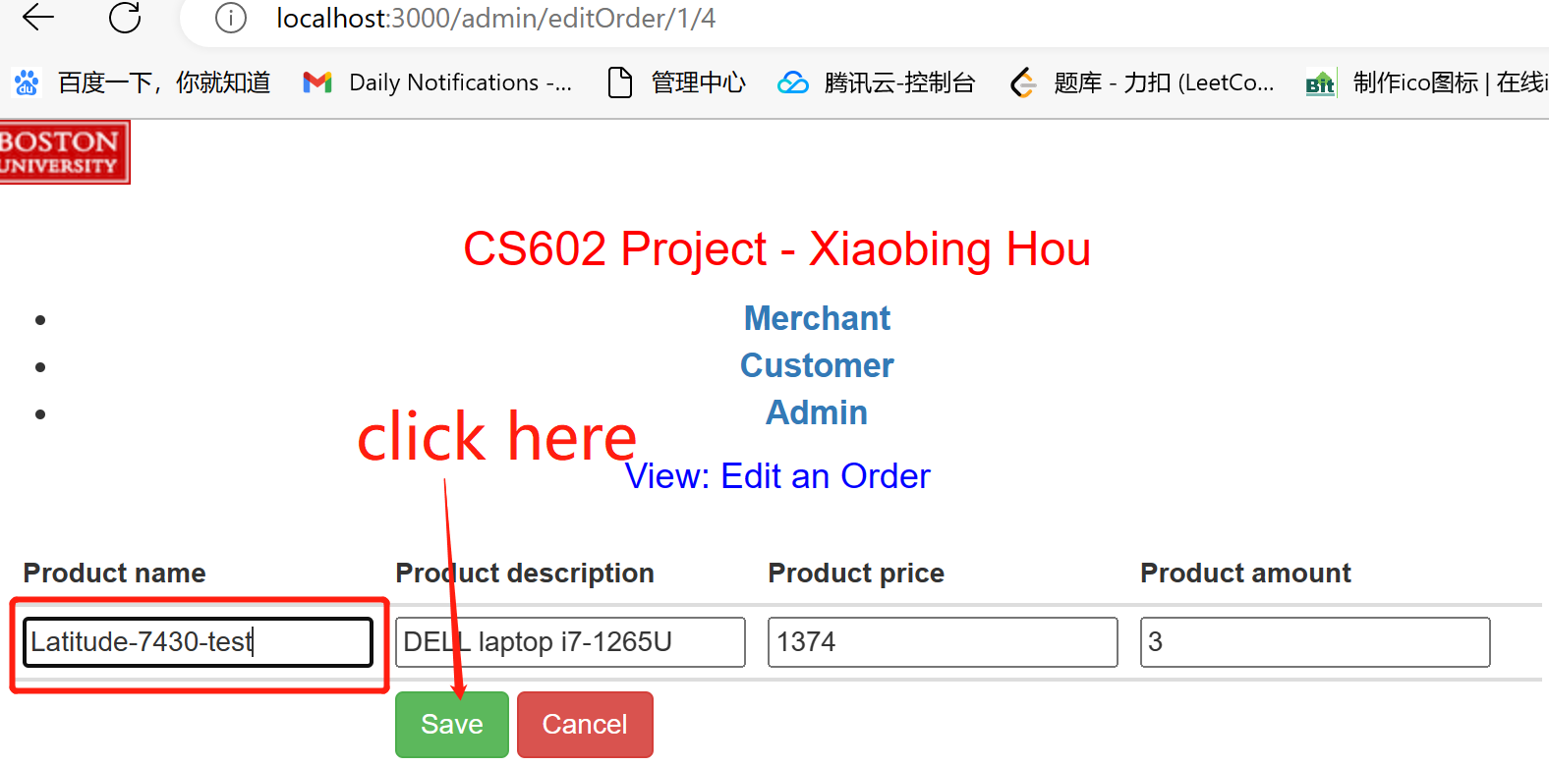
Demo presentation-Admin

Slide 10
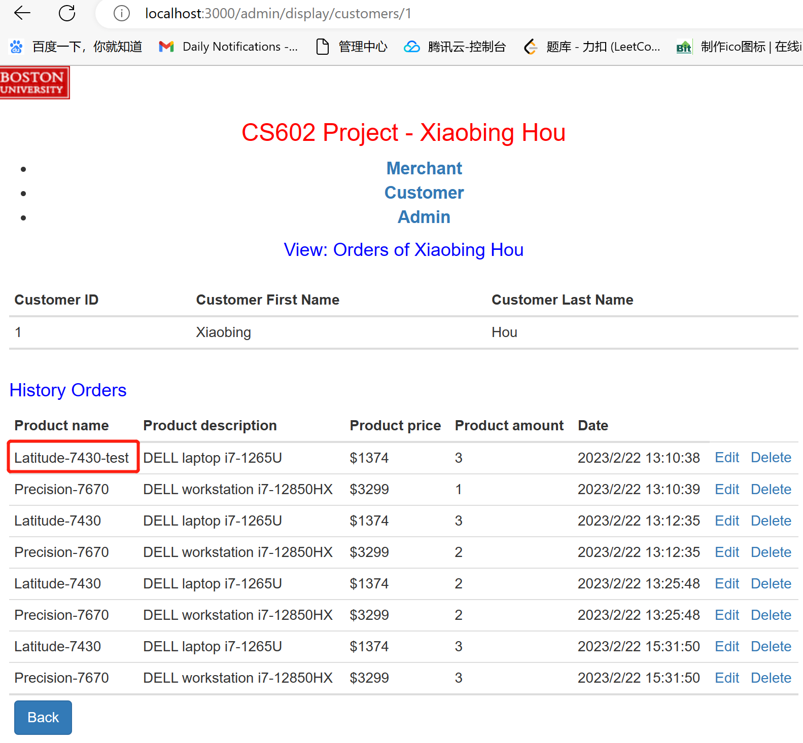
Demo presentation-Admin

Slide 11
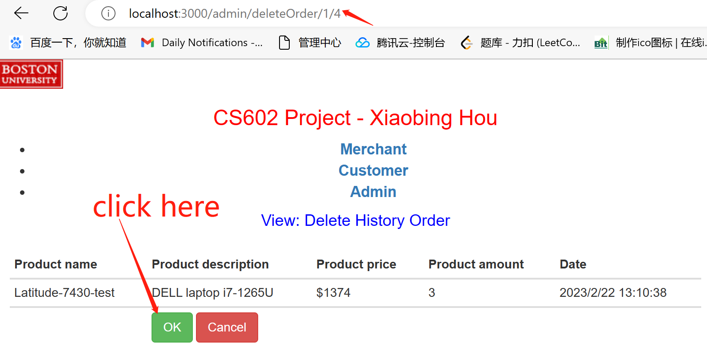
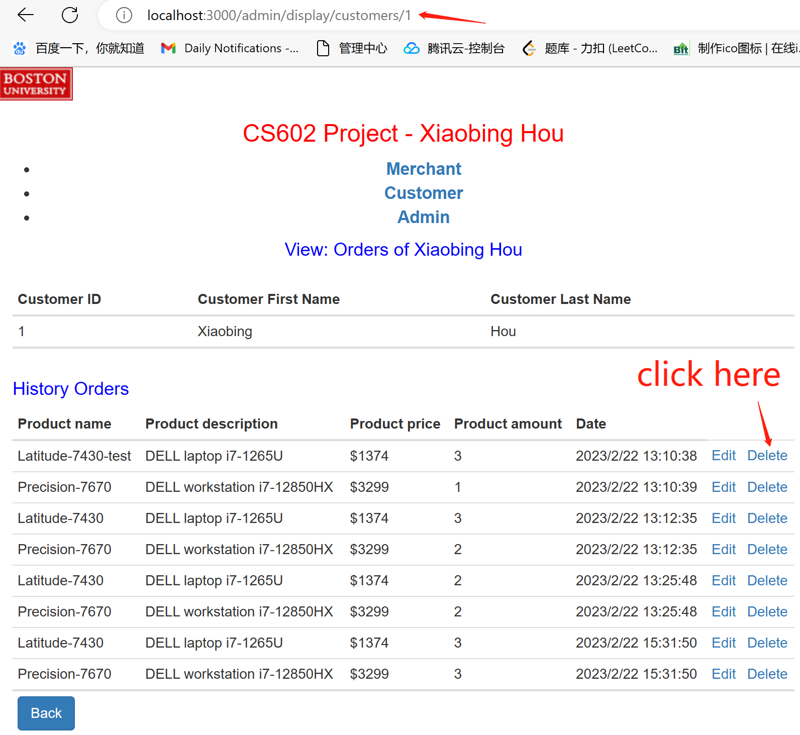
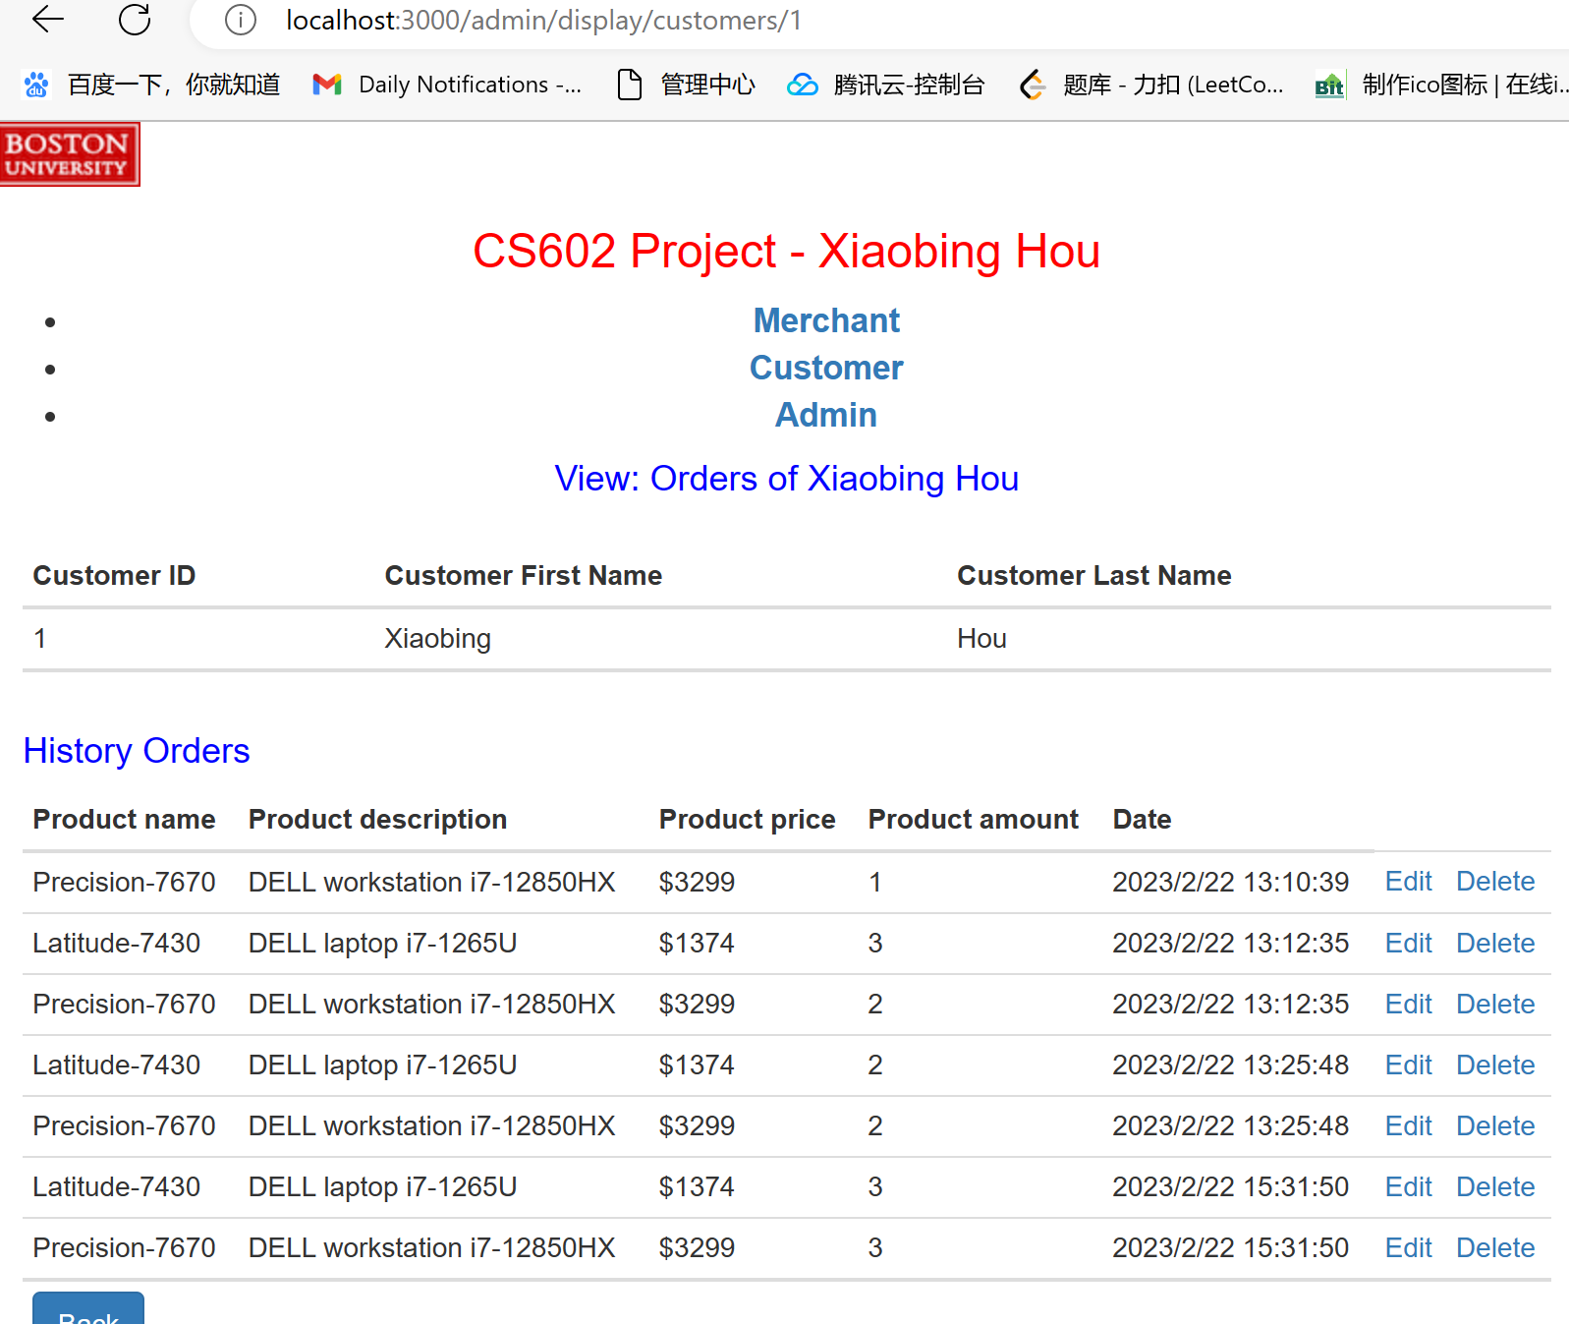
Demo presentation-Admin

Slide 12
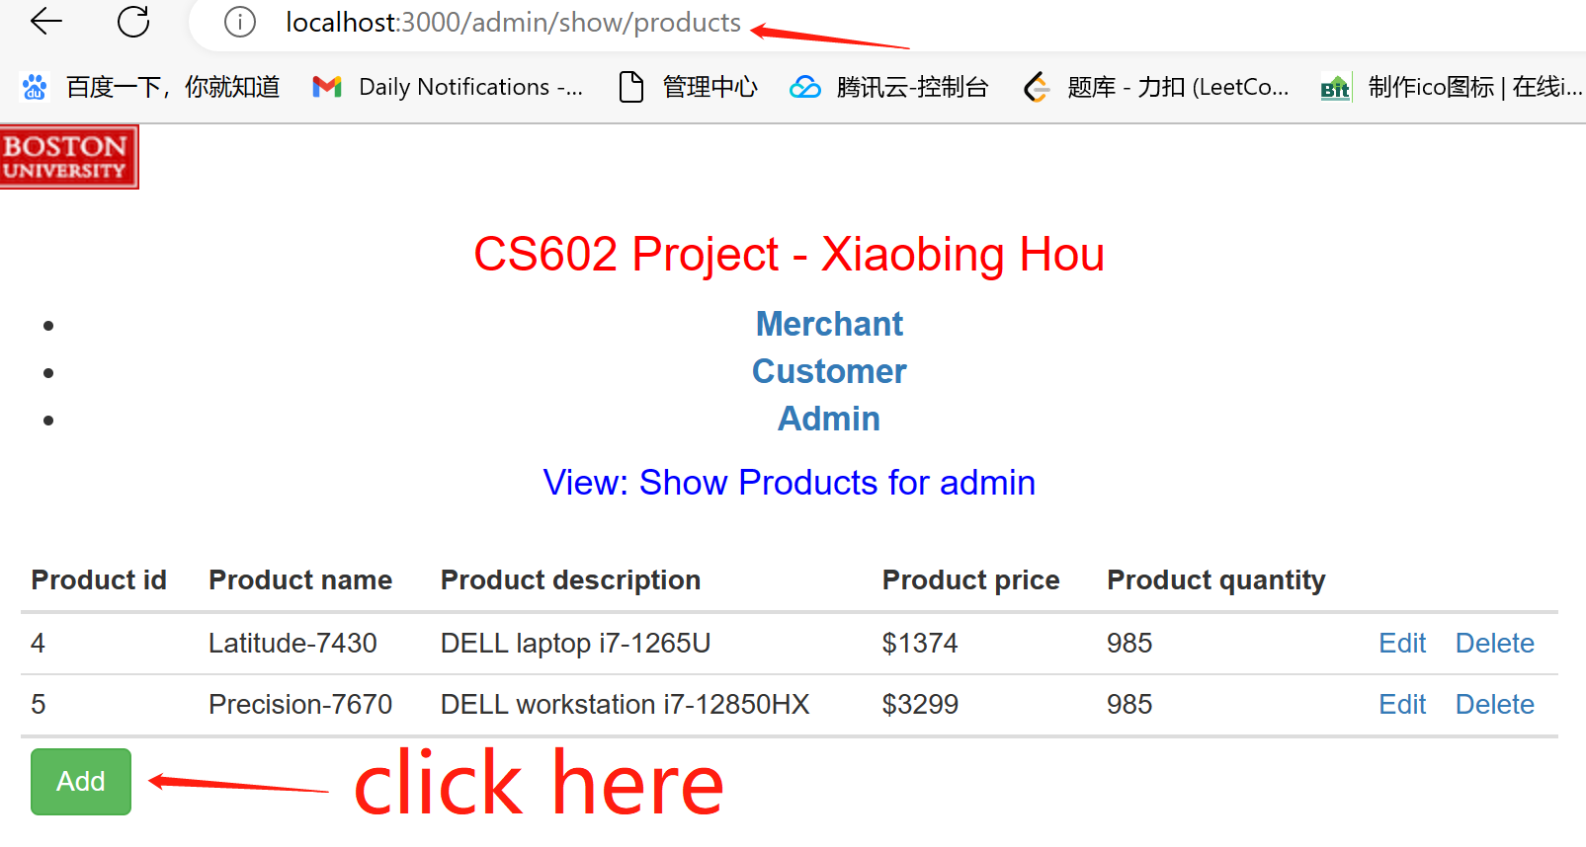
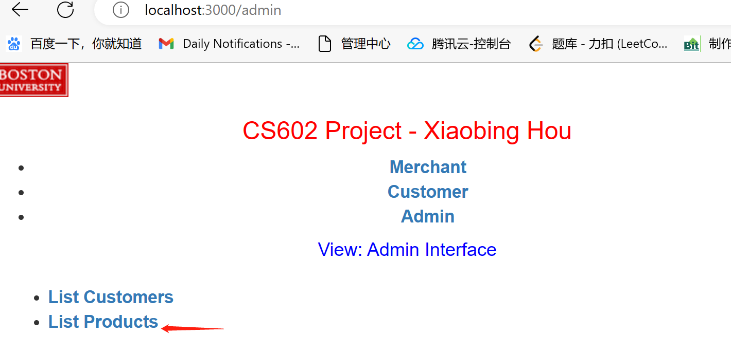
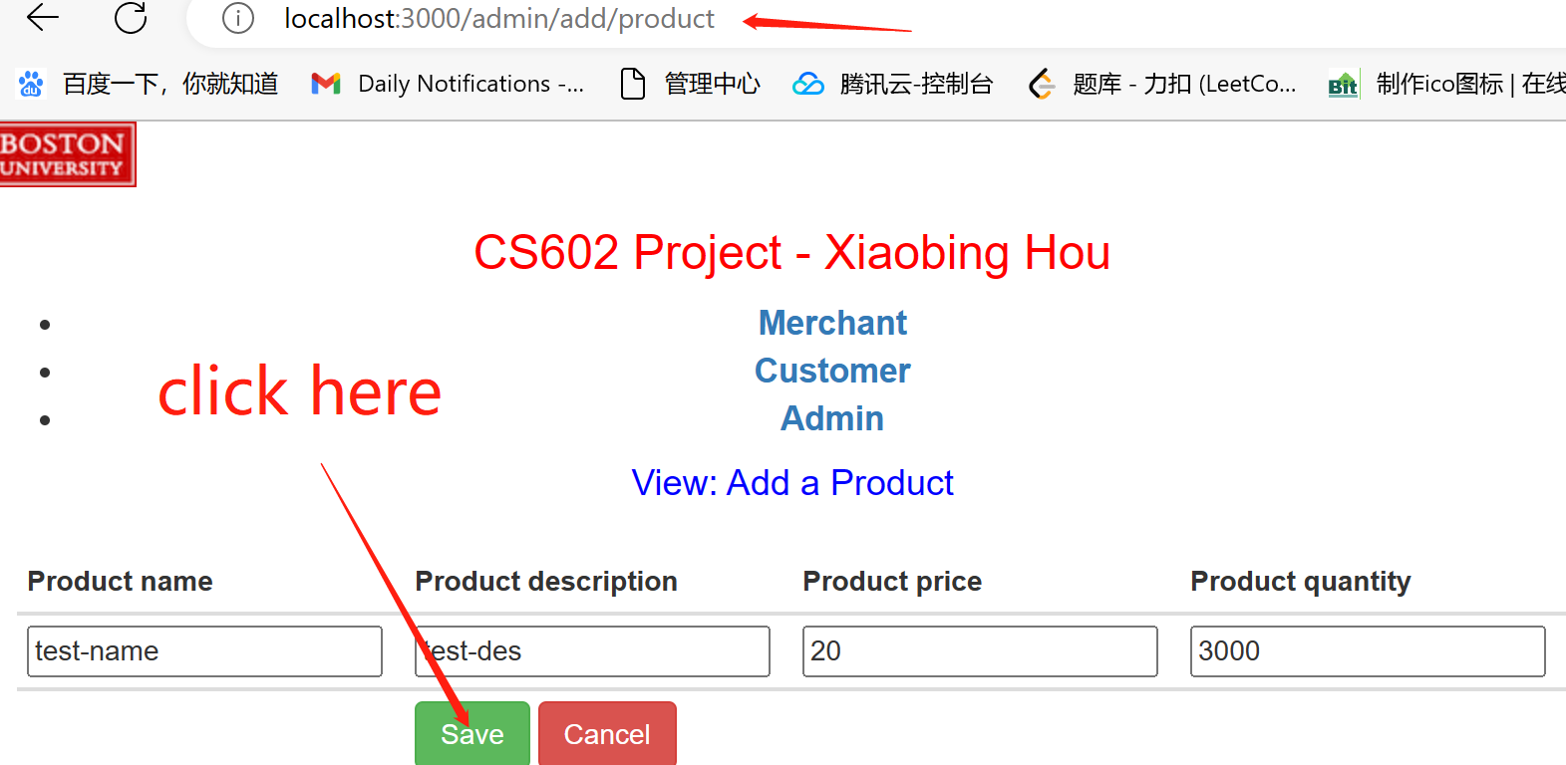

Demo presentation-Admin

Slide 13
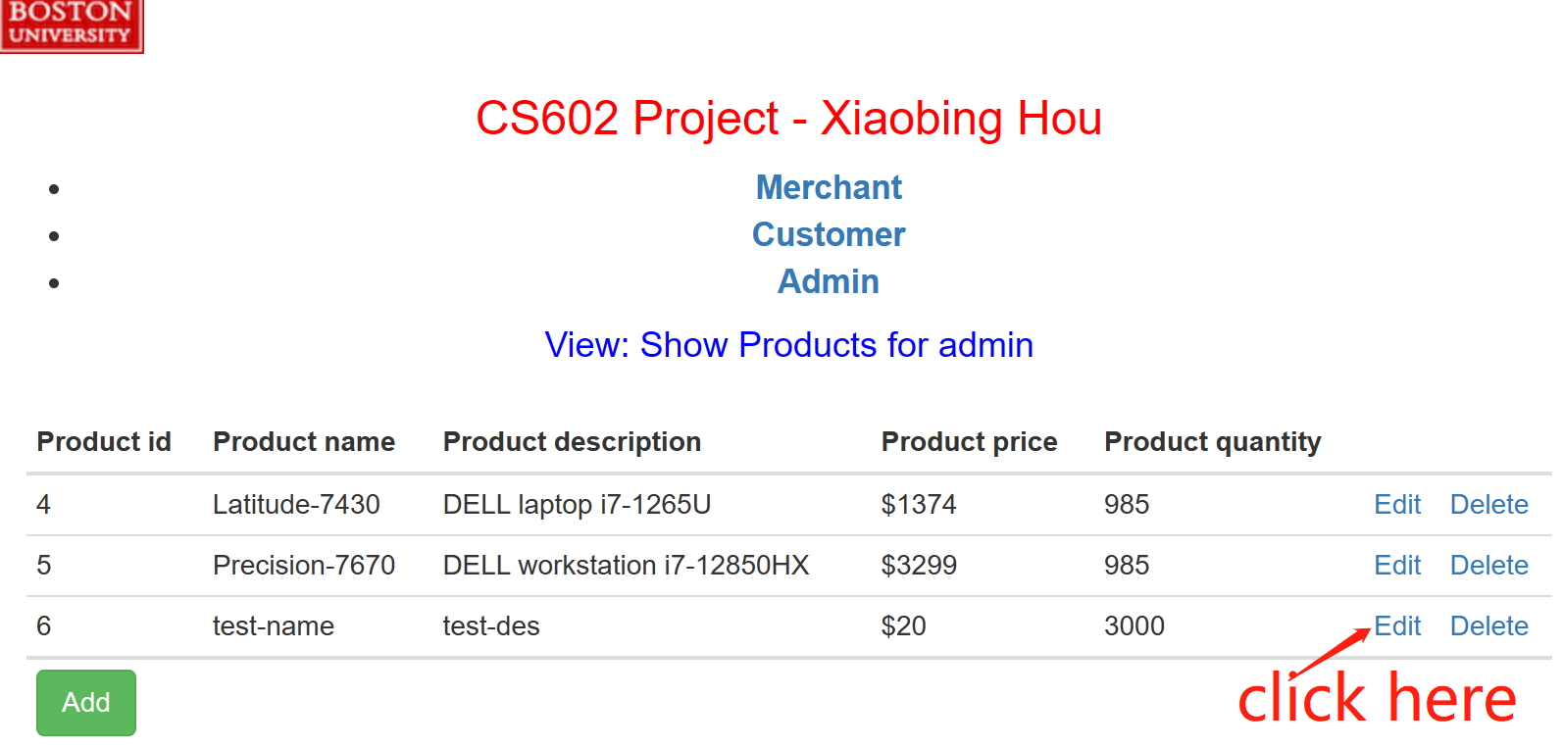
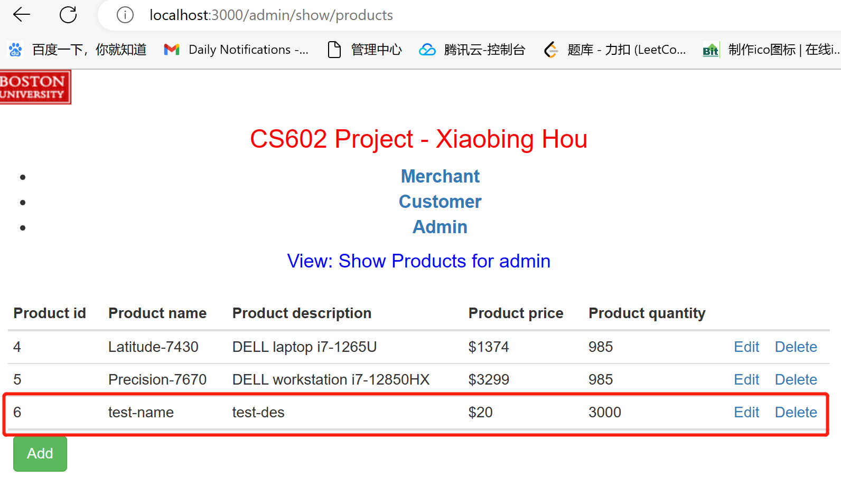
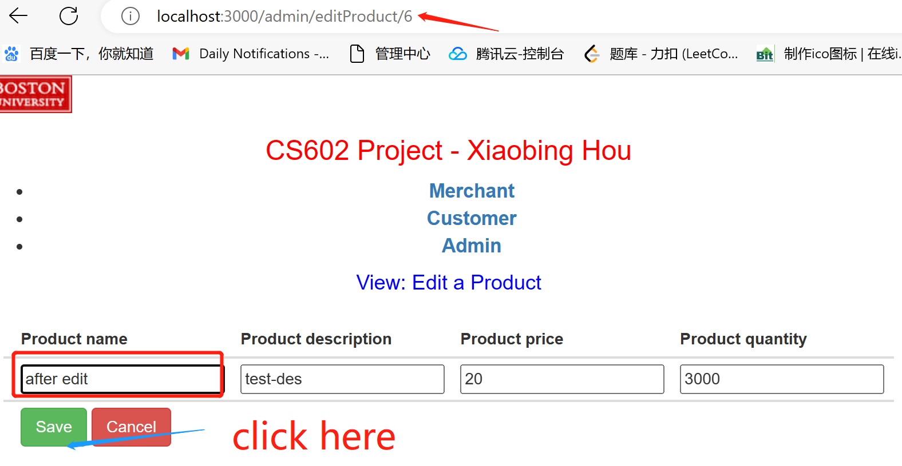
Demo presentation-Admin

Slide 14
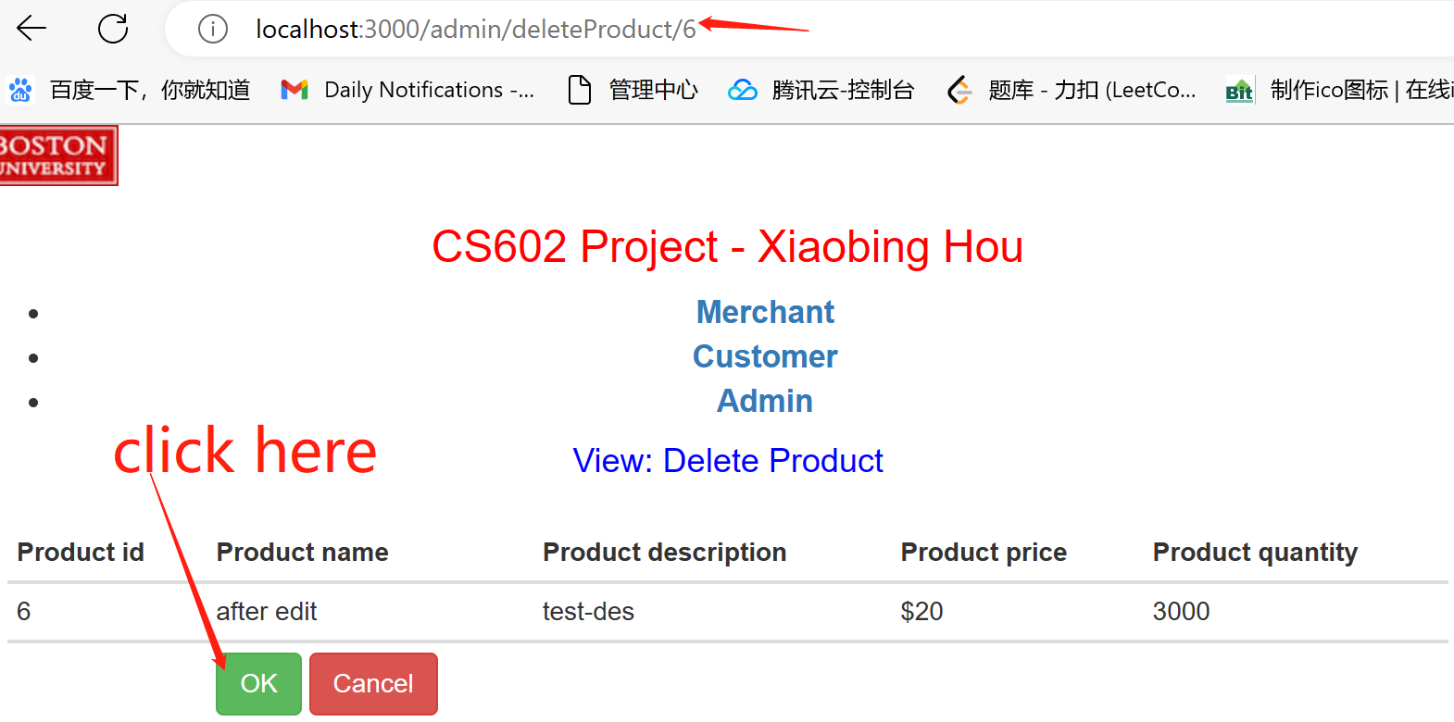
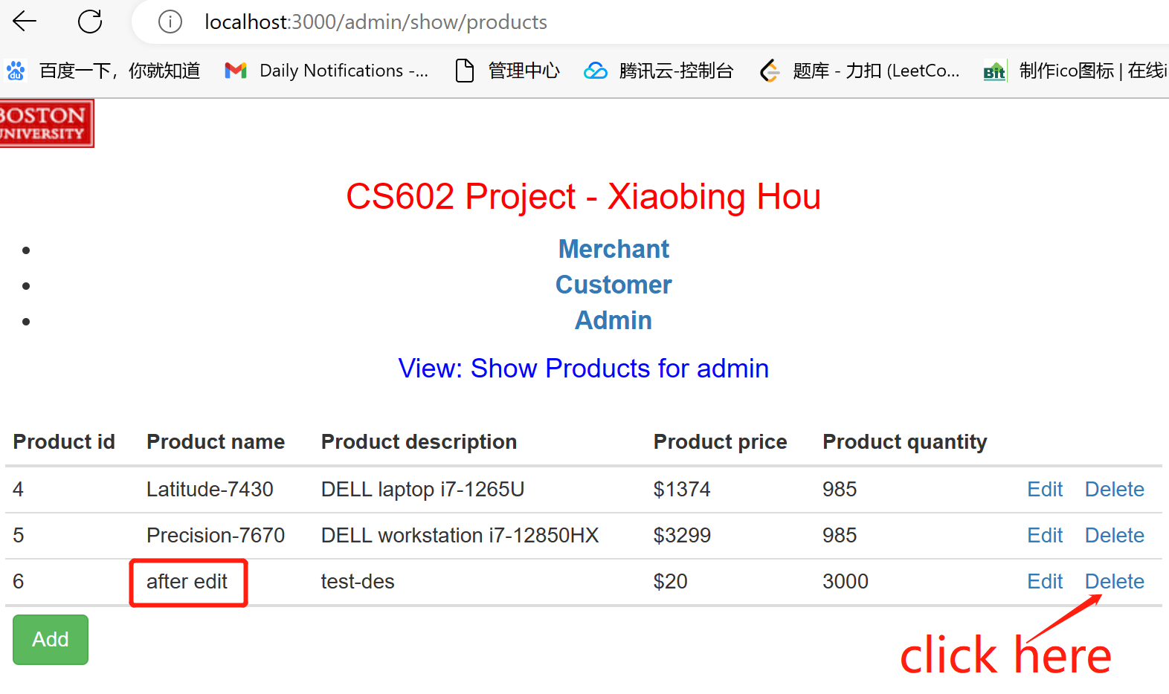
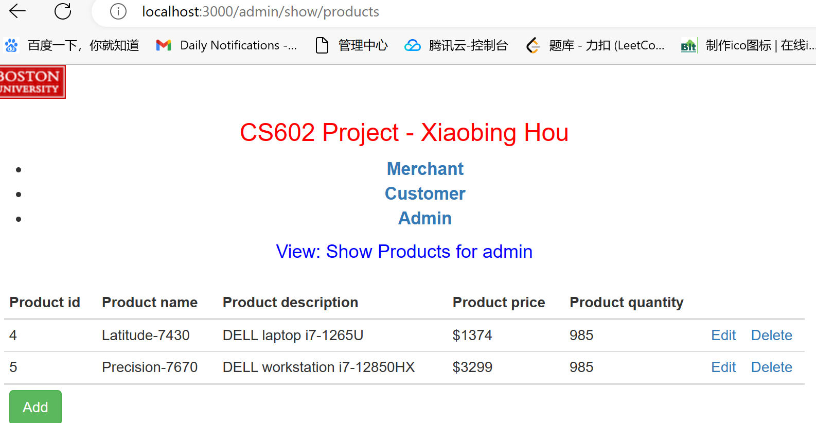
Demo presentation-Admin

Slide 15
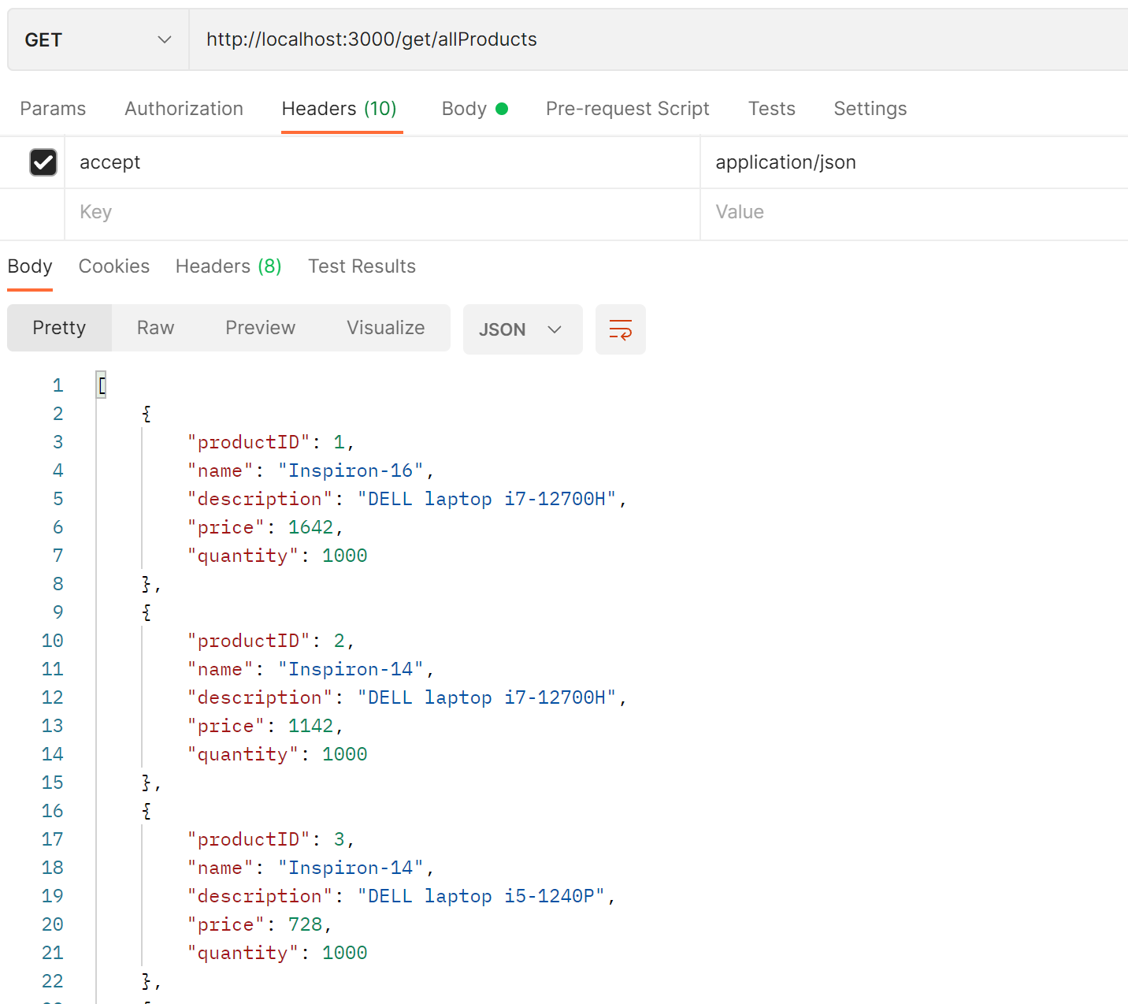
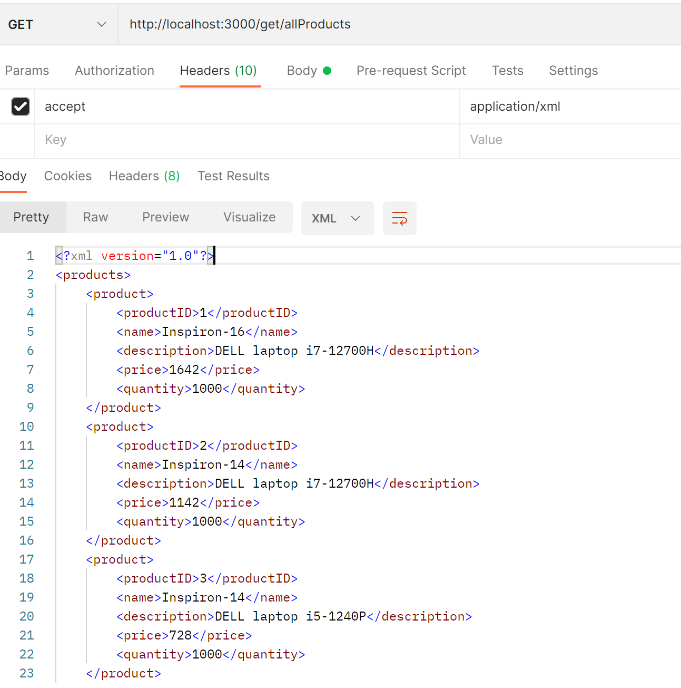
REST APIs Test-get all Products

Slide 16
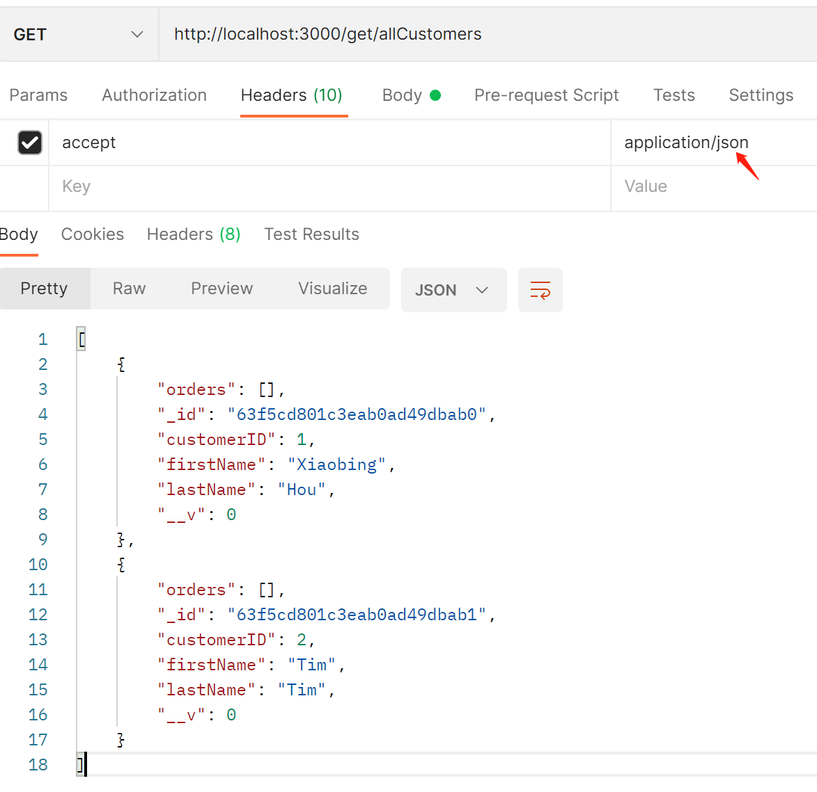
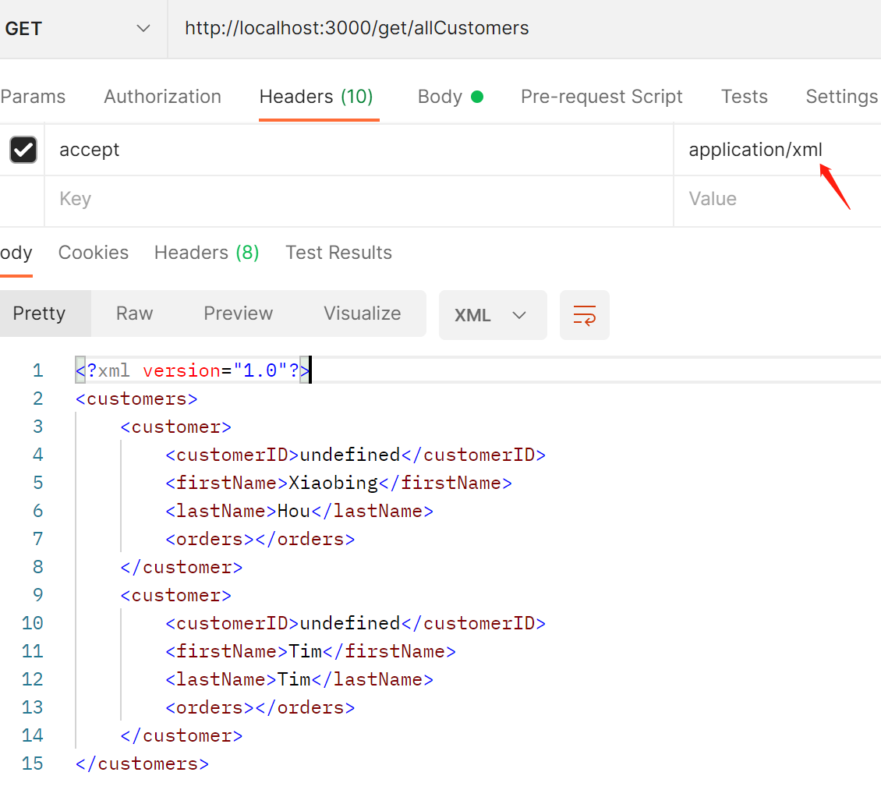
REST APIs Test-get all Customers

Slide 17
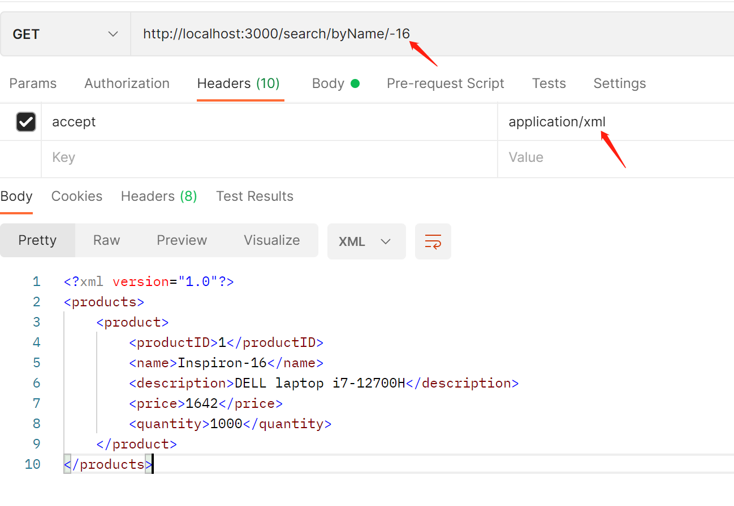
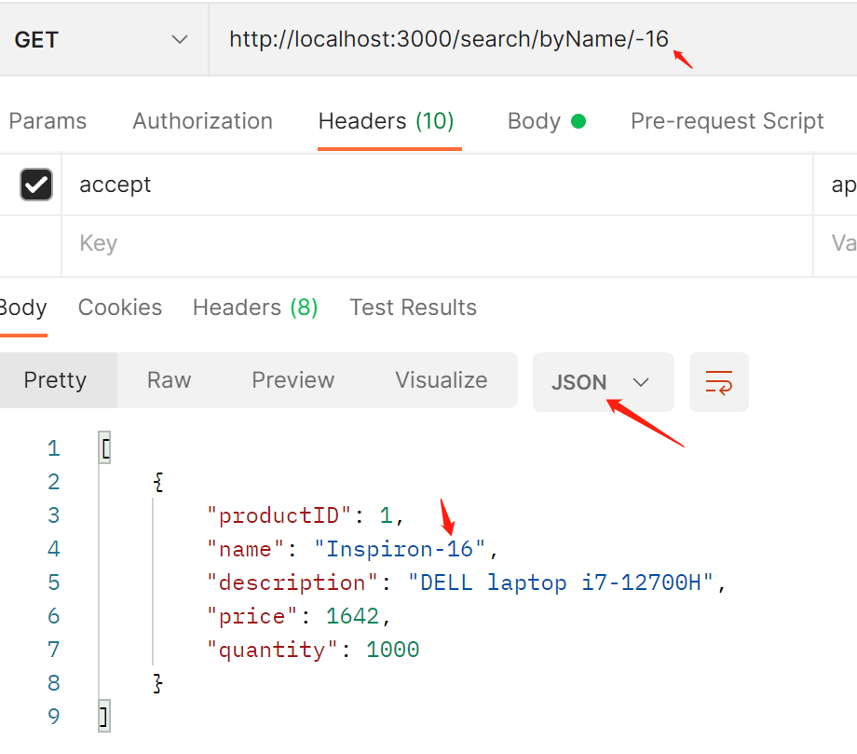
REST APIs Test-search products by name

Slide 18
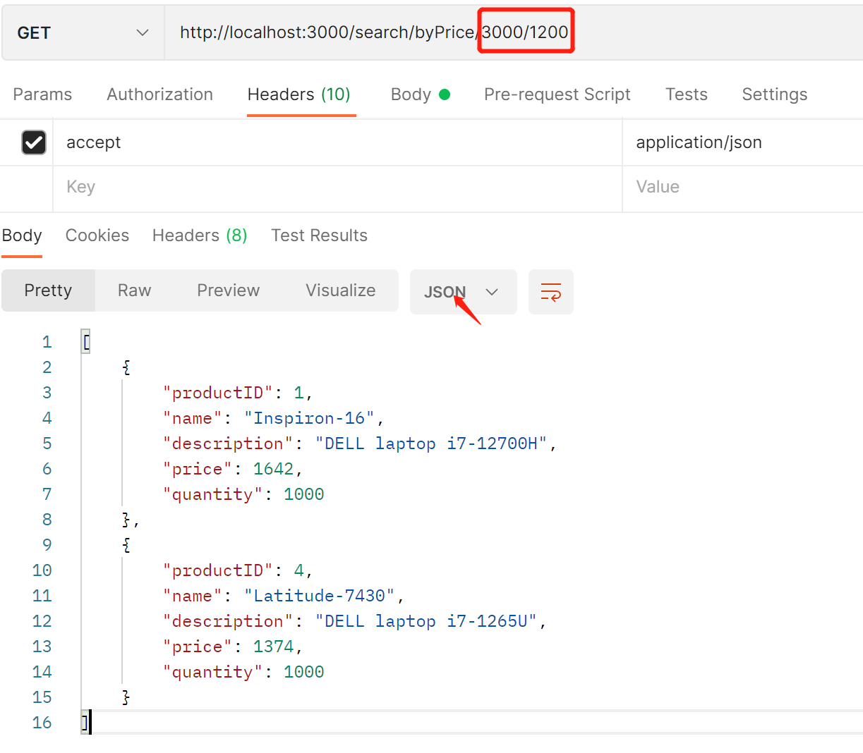
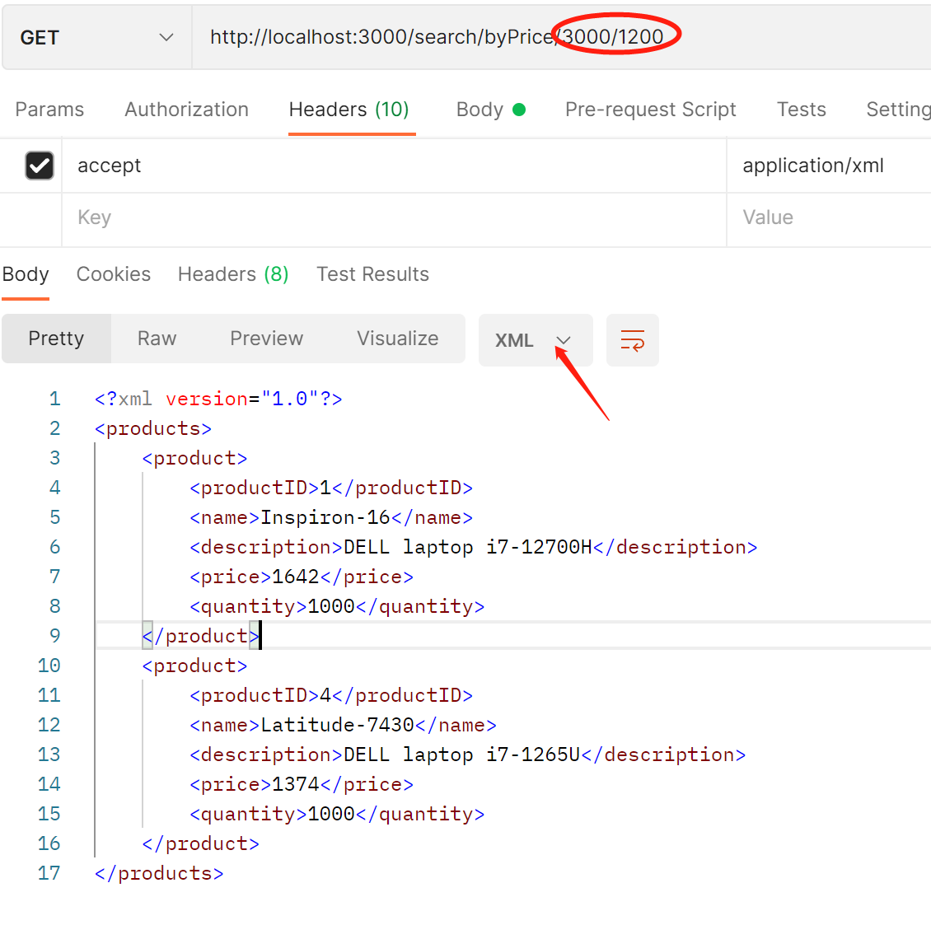
REST APIs Test-search products by price range

Slide 19
Thank You

